Slide 1


KDE petrophysical inversion using
DMS approach for data conditioning
Fernando Bordignon, Computer Science PhD
www.ltrace.com.br
fernando@ltrace.com.br

Slide 2
Comparing the Approaches
Computational time
RAM memory
 | 4-variate | 7-variate
Traditional | 0.56 sec | 446 sec
DMS approach | 1.59 sec | 2.68 sec
 | 4-variate | 7-variate
Traditional | 2 GB | 183GB
DMS approach | 2 GB | 2 GB

Slide 3
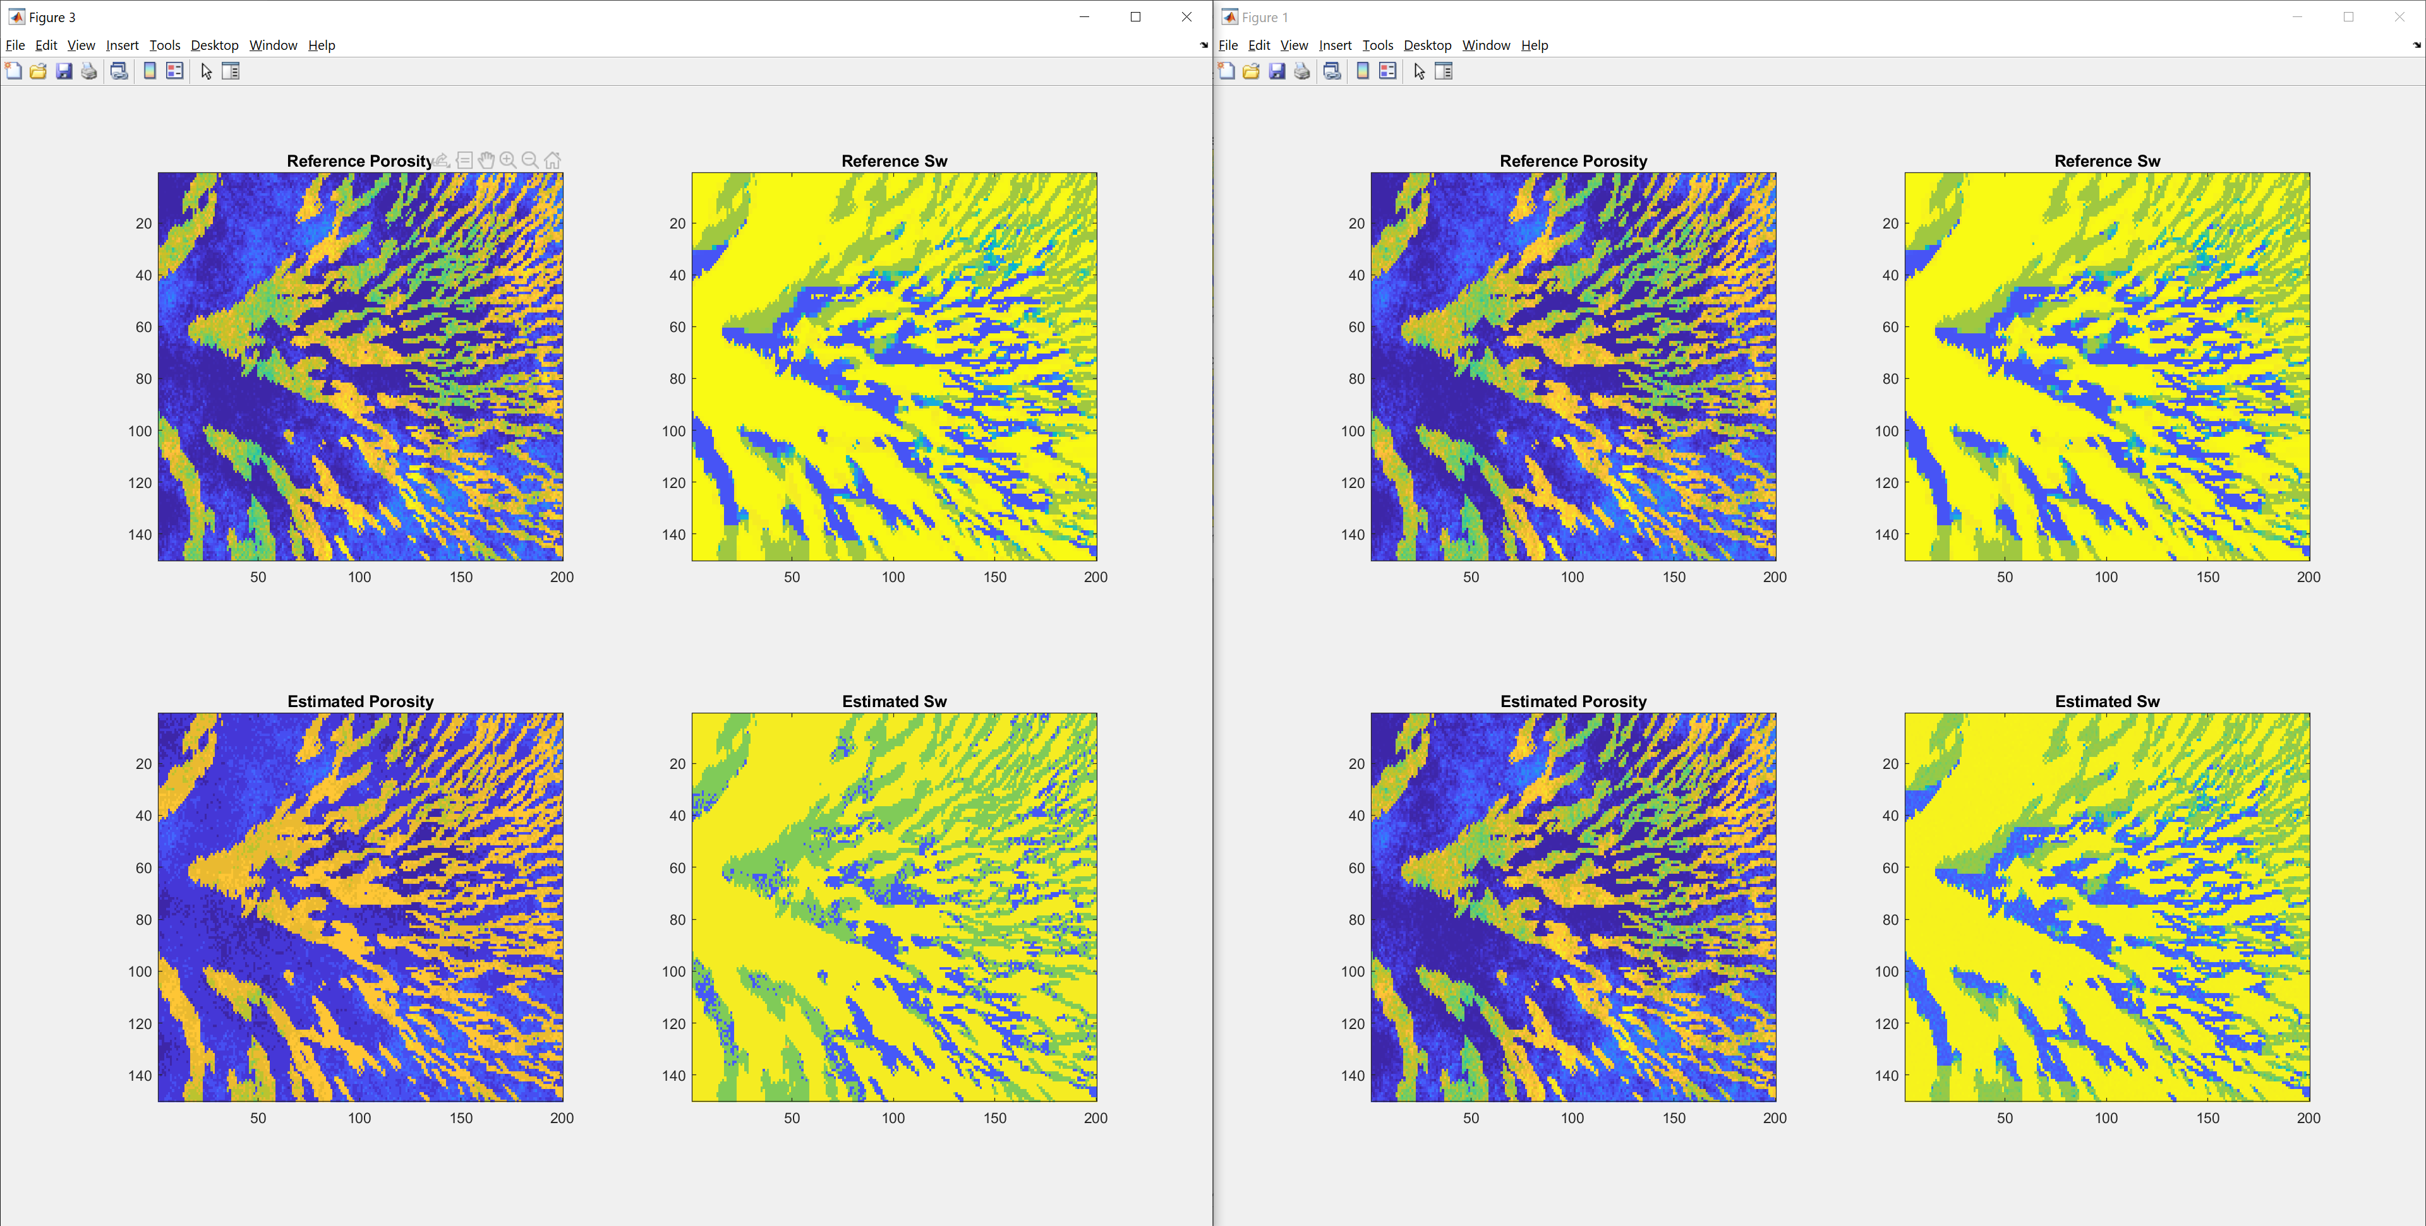
Traditional:
DMS approach:

Slide 4
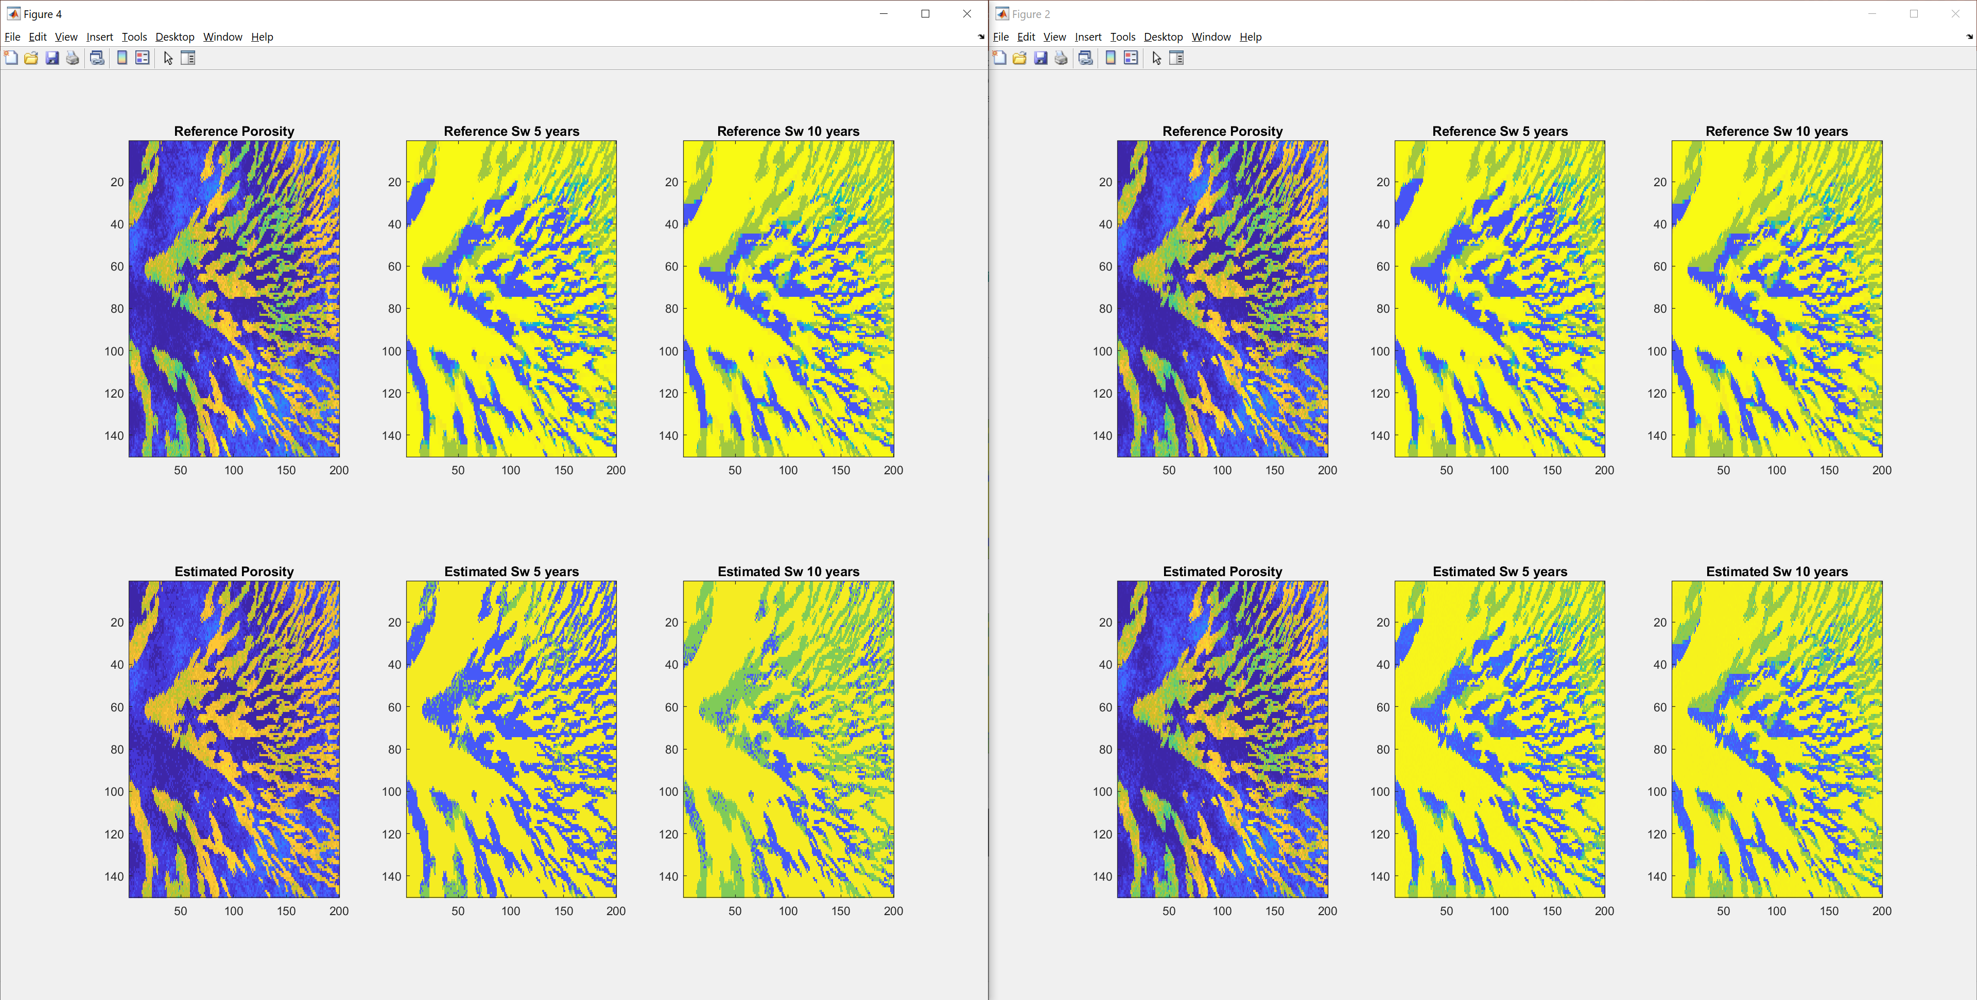
Traditional:
DMS approach:

Slide 6
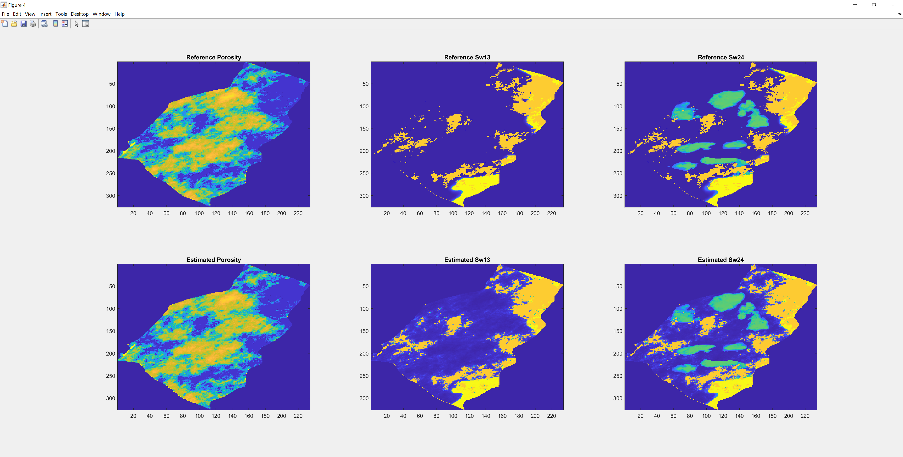
Noise Free

Slide 7
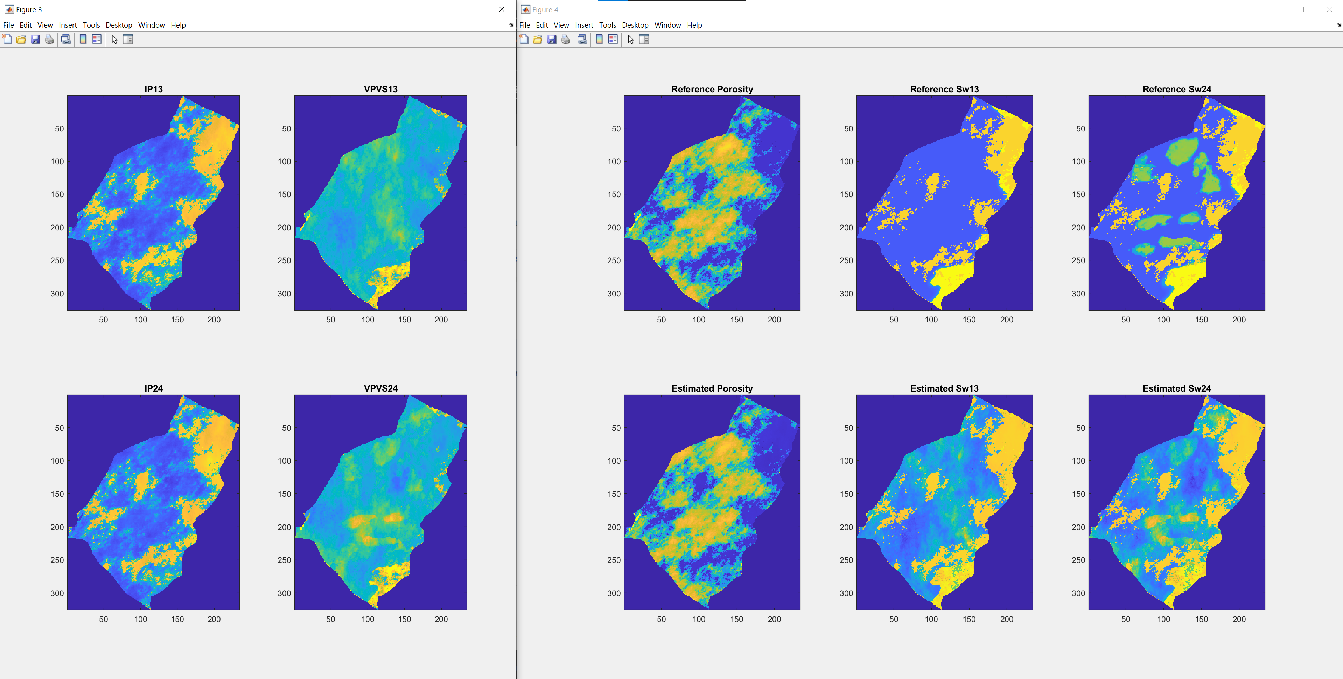
std_vp = 50; std_vs = 25; std_rho = 0.05; crit_por = 0.4

Slide 8
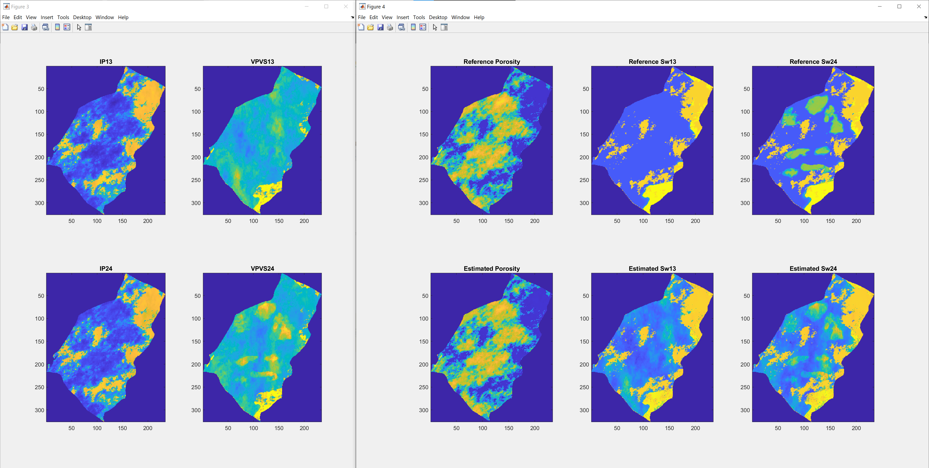
std_vp = 50; std_vs = 25; std_rho = 0.05; crit_por = 0.3

Slide 9

Thank you
www.ltrace.com.br
Fernando Bordignon
fernando@ltrace.com.br

